Slide 1
NBAC TSC Slides 31 October 2024 Meeting

Slide 2
31 October 2024 NBAC TSC Agenda
1:00 NBAC Co-Chair Opening Remarks – Mr. Kamran Atri & Thomas Krul
PGB Meeting 14 Nov, 2-4 PM
Join PGB Mailing List –email niemopen-pgb+subscribe@lists.oasis-open-projects.org
Attend 14 Nov meeting (see TEAMS link, next slide)
New sub-committees’ progress
Analytic Laboratory
Identity
Work continues Model Version 6.0 PS02
Work continues NDR 6
Training being updated to reflect Model Version 6
NIEMOpen Summit 19-20 Feb 2025 https://sites.google.com/oasis-open.org/niemopen-training-2025/home
Cancel or reschedule 28 Nov NBAC Meeting?
Cancel or reschedule 26 Dec NBAC Meeting?
1:10 NIEM Management Office (NMO) Update – Ms. Katherine Escobar
NIEMOpen and integration with other standards?
NIEMOpen Excellence Awards – Shunda Louis
https://niemopen.org/excellence-awards-2025/
1:20 NTAC Update – Dr. Scott Renner
1:30 Communications & Outreach NMO Sub-Committee update – Paul Wormeli
1:35 Community Updates - all
1:40 Questions/Final Remarks
Slides available in 31 October Minutes folder, NBAC Admin Repo
https://github.com/niemopen/nbac-admin/tree/main/nbac-meeting-minutes

Slide 3
Venue
Microsoft Teams 7 November 2024 PGB Meeting
PGB Meeting
14 November 2024
Virtual Meeting 2-4 PM EST
Virtual: MS TEAMS
Microsoft Teams
Join the meeting now
Meeting ID: 993 230 617 696
Passcode: qGzTqU
Dial in by phone
+1 410-874-6749,,202460060# United States, Odenton
Find a local number
Phone conference ID: 202 460 060#
PGB Minutes & documents: https://github.com/niemopen/oasis-open-project/tree/main/pgb-meeting-minutes

Slide 4
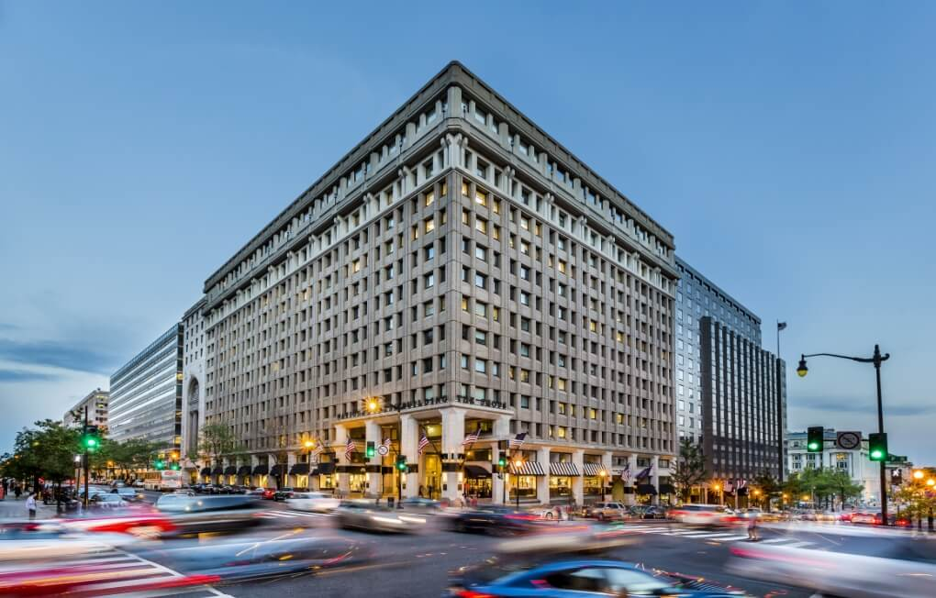
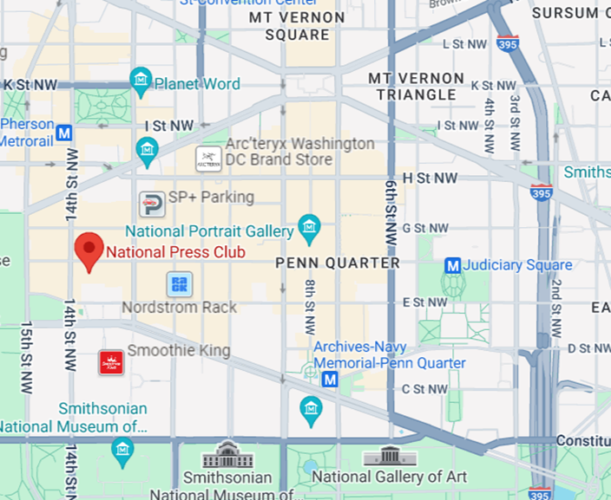
About the NIEM Reveal Training & Summit
A pivotal gathering driving advancements in information sharing and interoperability through immersive workshops, hands-on sessions, and insightful presentations.
Attendees gain a profound understanding of the latest NIEM architecture and are empowered to implement seamless, secure, and efficient information exchanges across organizational boundaries.
Tuesday, February 18 – Thursday, February 20
Washington D.C area (accessible to public transportation)
The National Press Club – 14th Street, NW
https://niemopen.org/reveal

Slide 5
Ways to learn more about the event and sponsorship opportunities
Visit the event website: https://niemopen.org/reveal
Download the sponsorship prospectus: https://niemopen.org/wp-content/uploads/2024/04/Summit-Sponsor-Info.pdf
Contact us directly: events@oasis-open.org

Slide 6








resources
Follow Us On Twitter
Katherine Escobar, katherine.b.escobar.civ@mail.mil, 7575-203-8631
Beth Smalley, beth.l.smalley.civ@mail.mil, 757-203-7177
Darcy Staley, darcy.a.staley.civ@mail.mil, 757-203-8711
Stephen Sullivan, stephen.m.sullivan14.ctr@mail.mil , 757-203-8619
https://twitter.com/NIEMconnects?ref_src=twsrc%5Etfw
https://www.niem.gov/
https://niemopen.org/
https://www.linkedin.com/groups/1903175/profile
Git Repos
NIEMOpen: https://github.com/niemopen/
NTAC TSC
https://github.com/niemopen/ntac-admin
NBAC TSC
https://github.com/niemopen/nbac-admin
NMO TSC
https://github.com/niemopen/nmo-admin
https://github.com/niemopen/nmo-training
NIEMOpen Slack Channel: https://niemopen.slack.com/
Mailing Lists
NIEMOpen: https://lists.oasis-open-projects.org/g/niemopen
PGB: https://lists.oasis-open-projects.org/g/niemopen-pgb
NTAC TSC: https://lists.oasis-open-projects.org/g/niemopen-ntactsc
NBAC TSC: https://lists.oasis-open-projects.org/g/niemopen-nbactsc
NMO TSC: https://lists.oasis-open-projects.org/g/niemopen-nmotsc
https://www.youtube.com/channel/UCg9qV22PXLBjG41hc-EwVrQ
MEP Registry & Repository
MEP Tool: https://mep.niemopen.org
CMFTool: https://github.com/niemopen/cmftool
NDR draft: “ndr6-outline.md” at https://github.com/niemopen/niem-naming-design-rules/blob/dev/ndr-v6.0-psd01.md
NIEMOpen Reveal Summit 18-20 Feb 2025

